Slide 1
KANO STATE HEALTH TRUST FUND (KHETFUND) ACHIEVEMENT PICTURES FROM MAY 203 To DATE

Slide 2
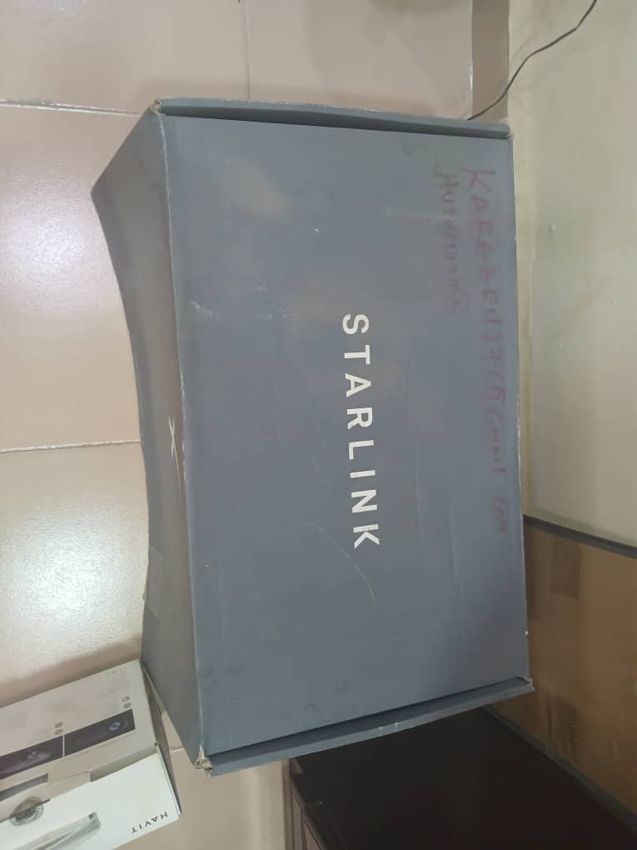
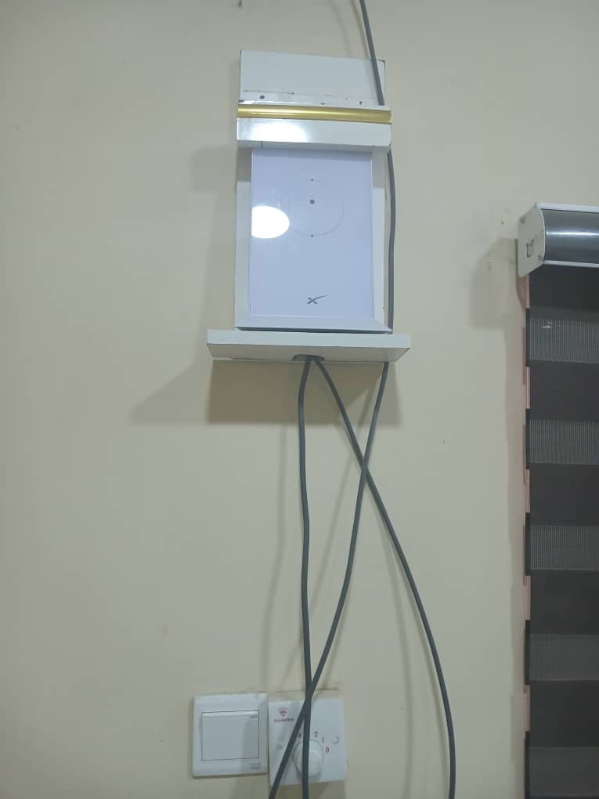
.
INSTALLATION OF STARLINK NETWORK @ KHETFUND

Slide 3
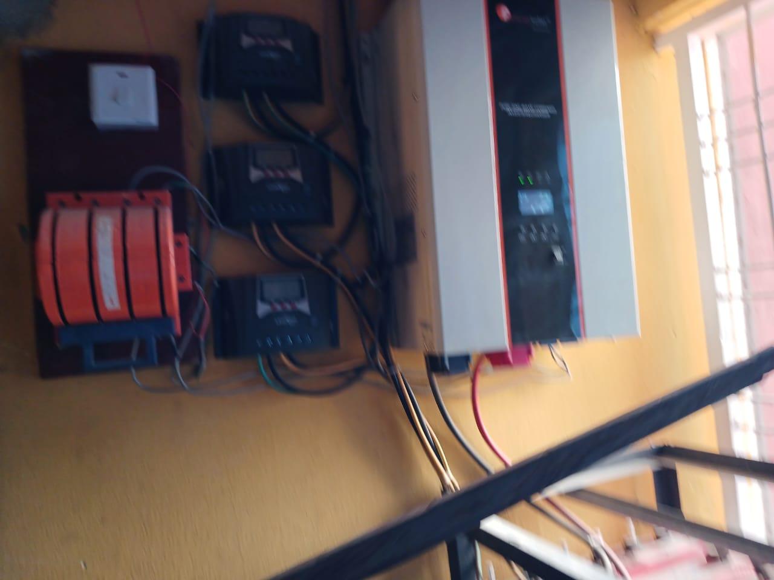
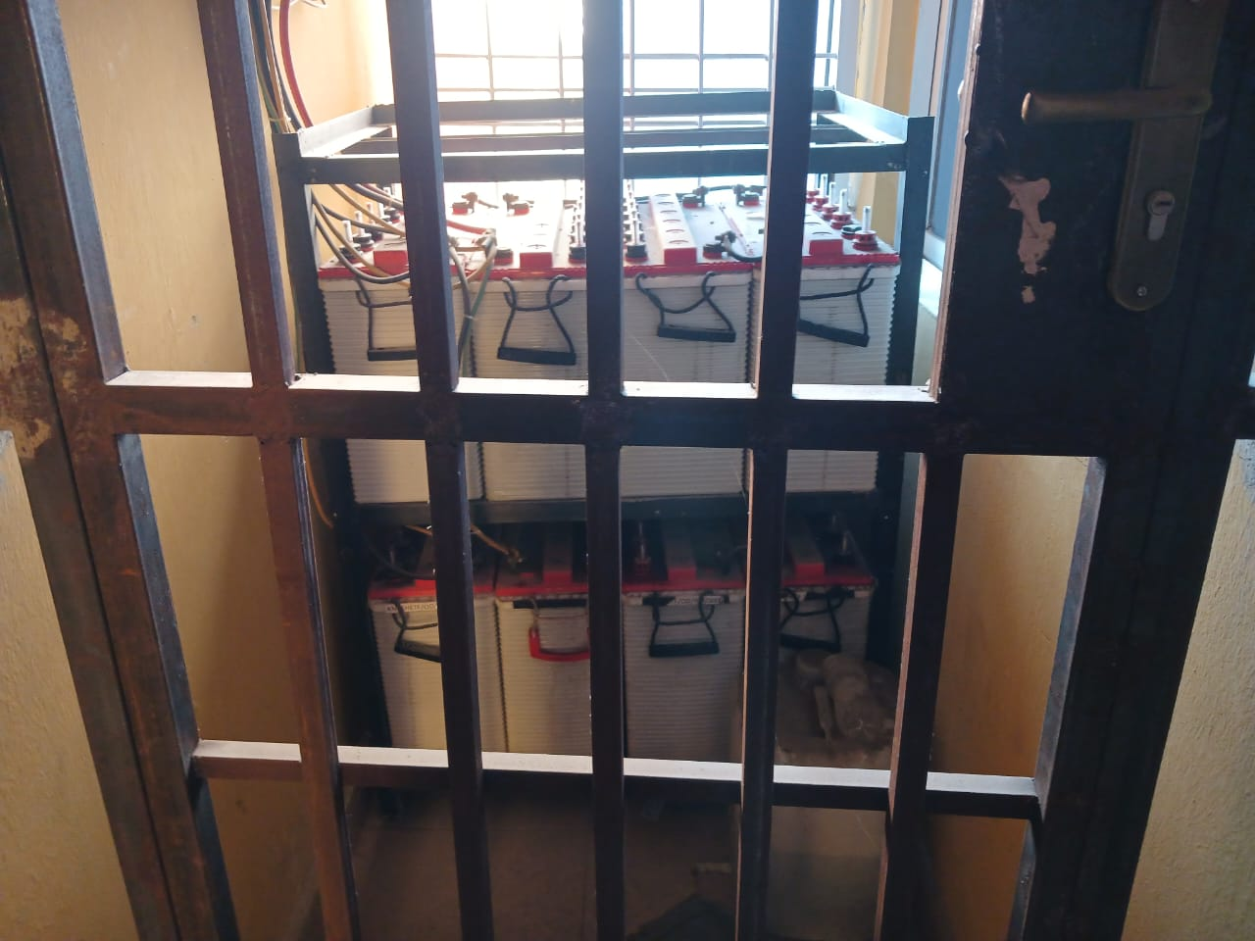
INSTALLATION OF SOLAR @ KHETFUND

Slide 4
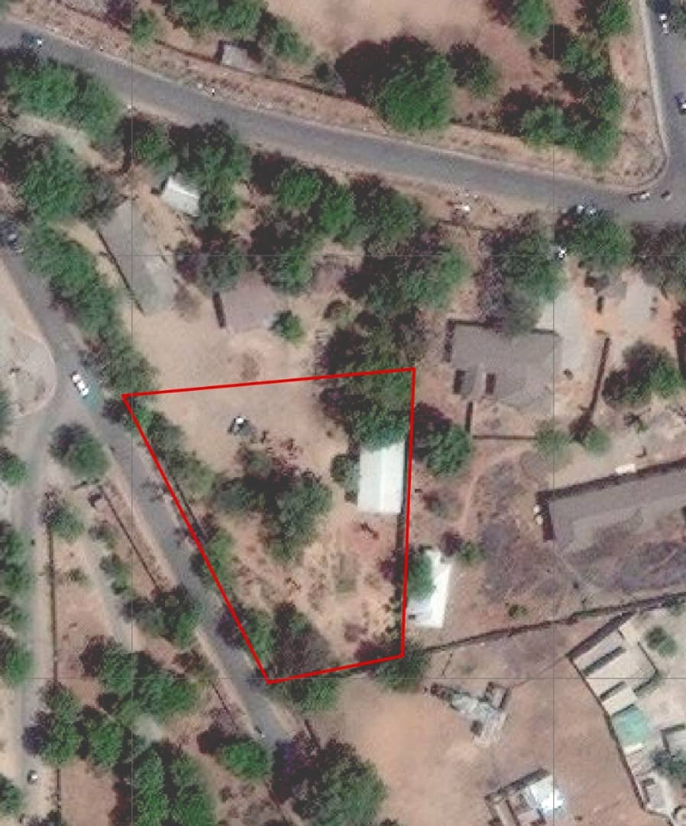
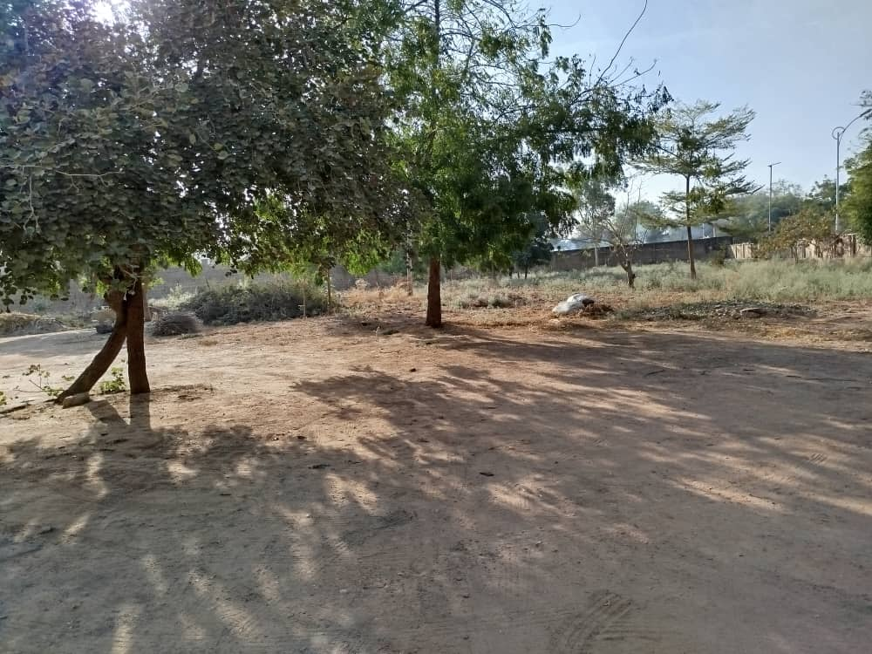
LAND FOR KHETFUND PERMANENT OFFICE ACCOMODATION

Slide 5
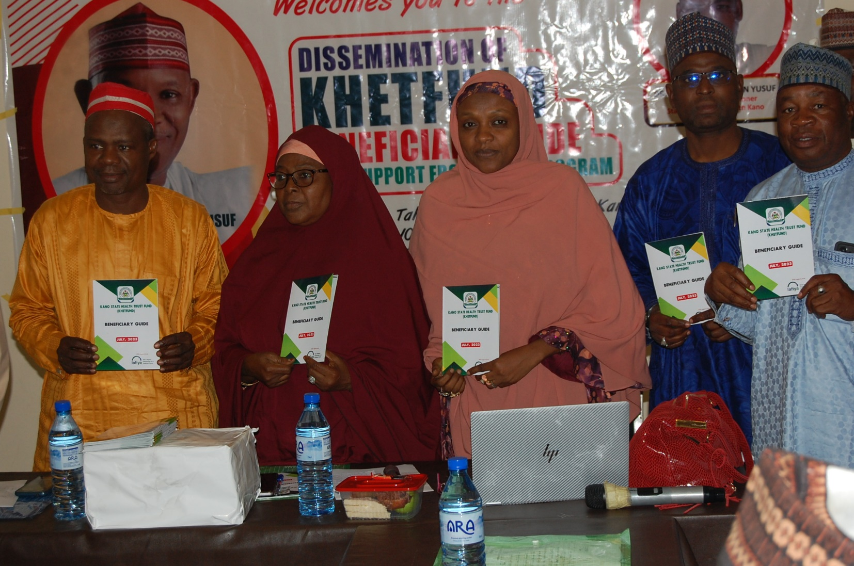
.
PRINTING AND DISSEMINATION OF
KHETFUND BENEFICIARY GUIDE

Slide 6
.
Office Equipment/Furniture @ College of Health Science and Technology

Slide 7
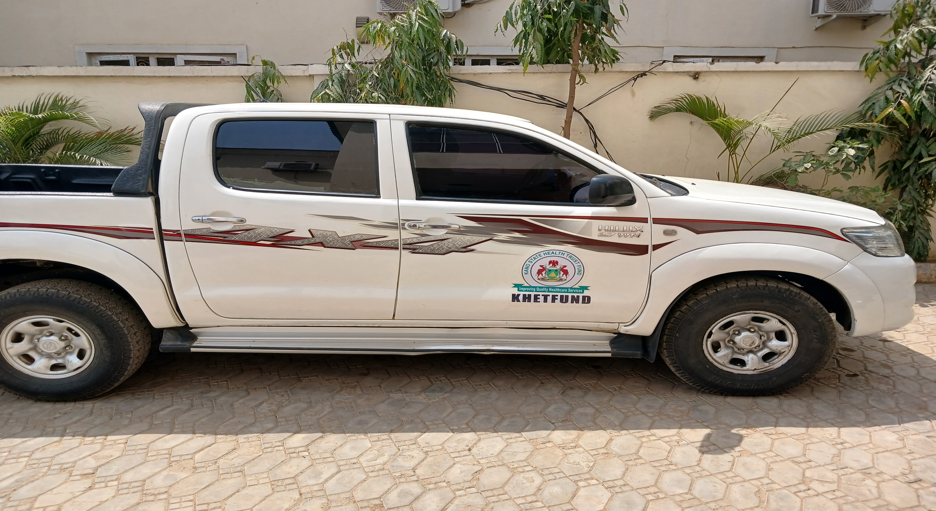
.
KHETFUND OPERATIONAL VEHICLE

Slide 8
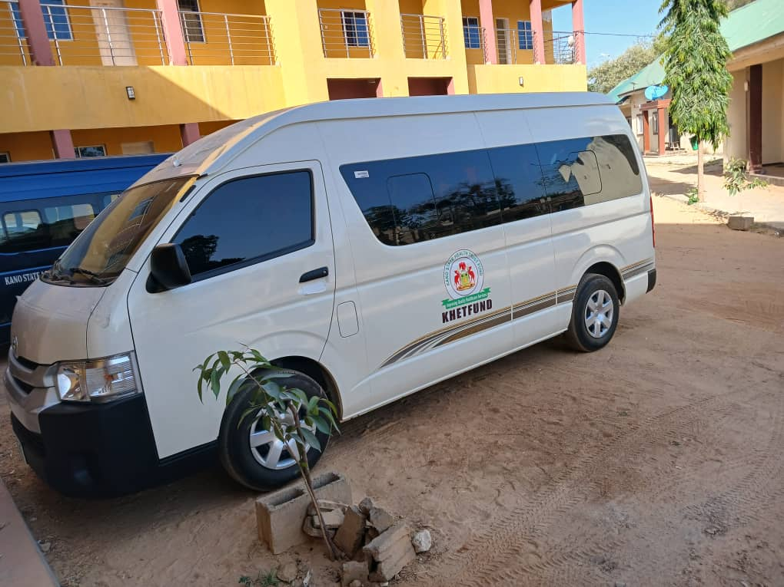
.
KHETFUND OPERATIONAL VEHICLE

Slide 9
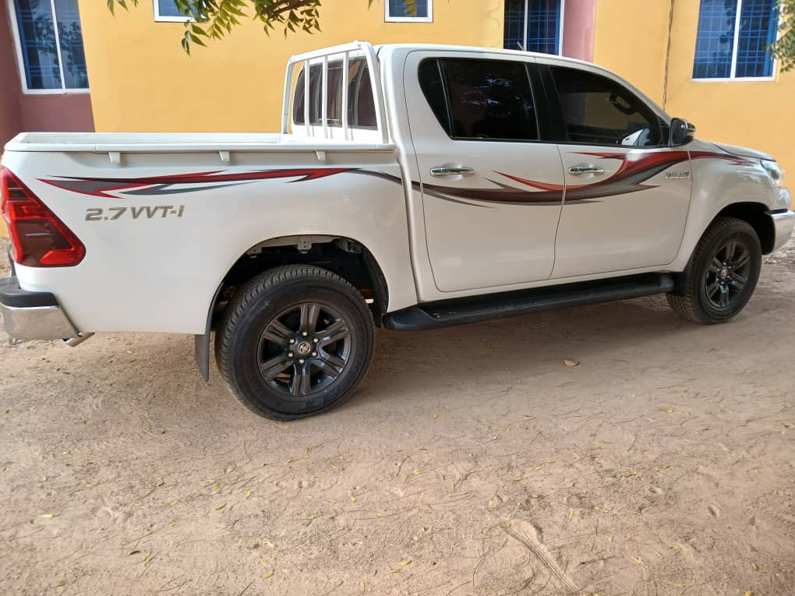
.
KHETFUND OPERATIONAL VEHICLE

Slide 10
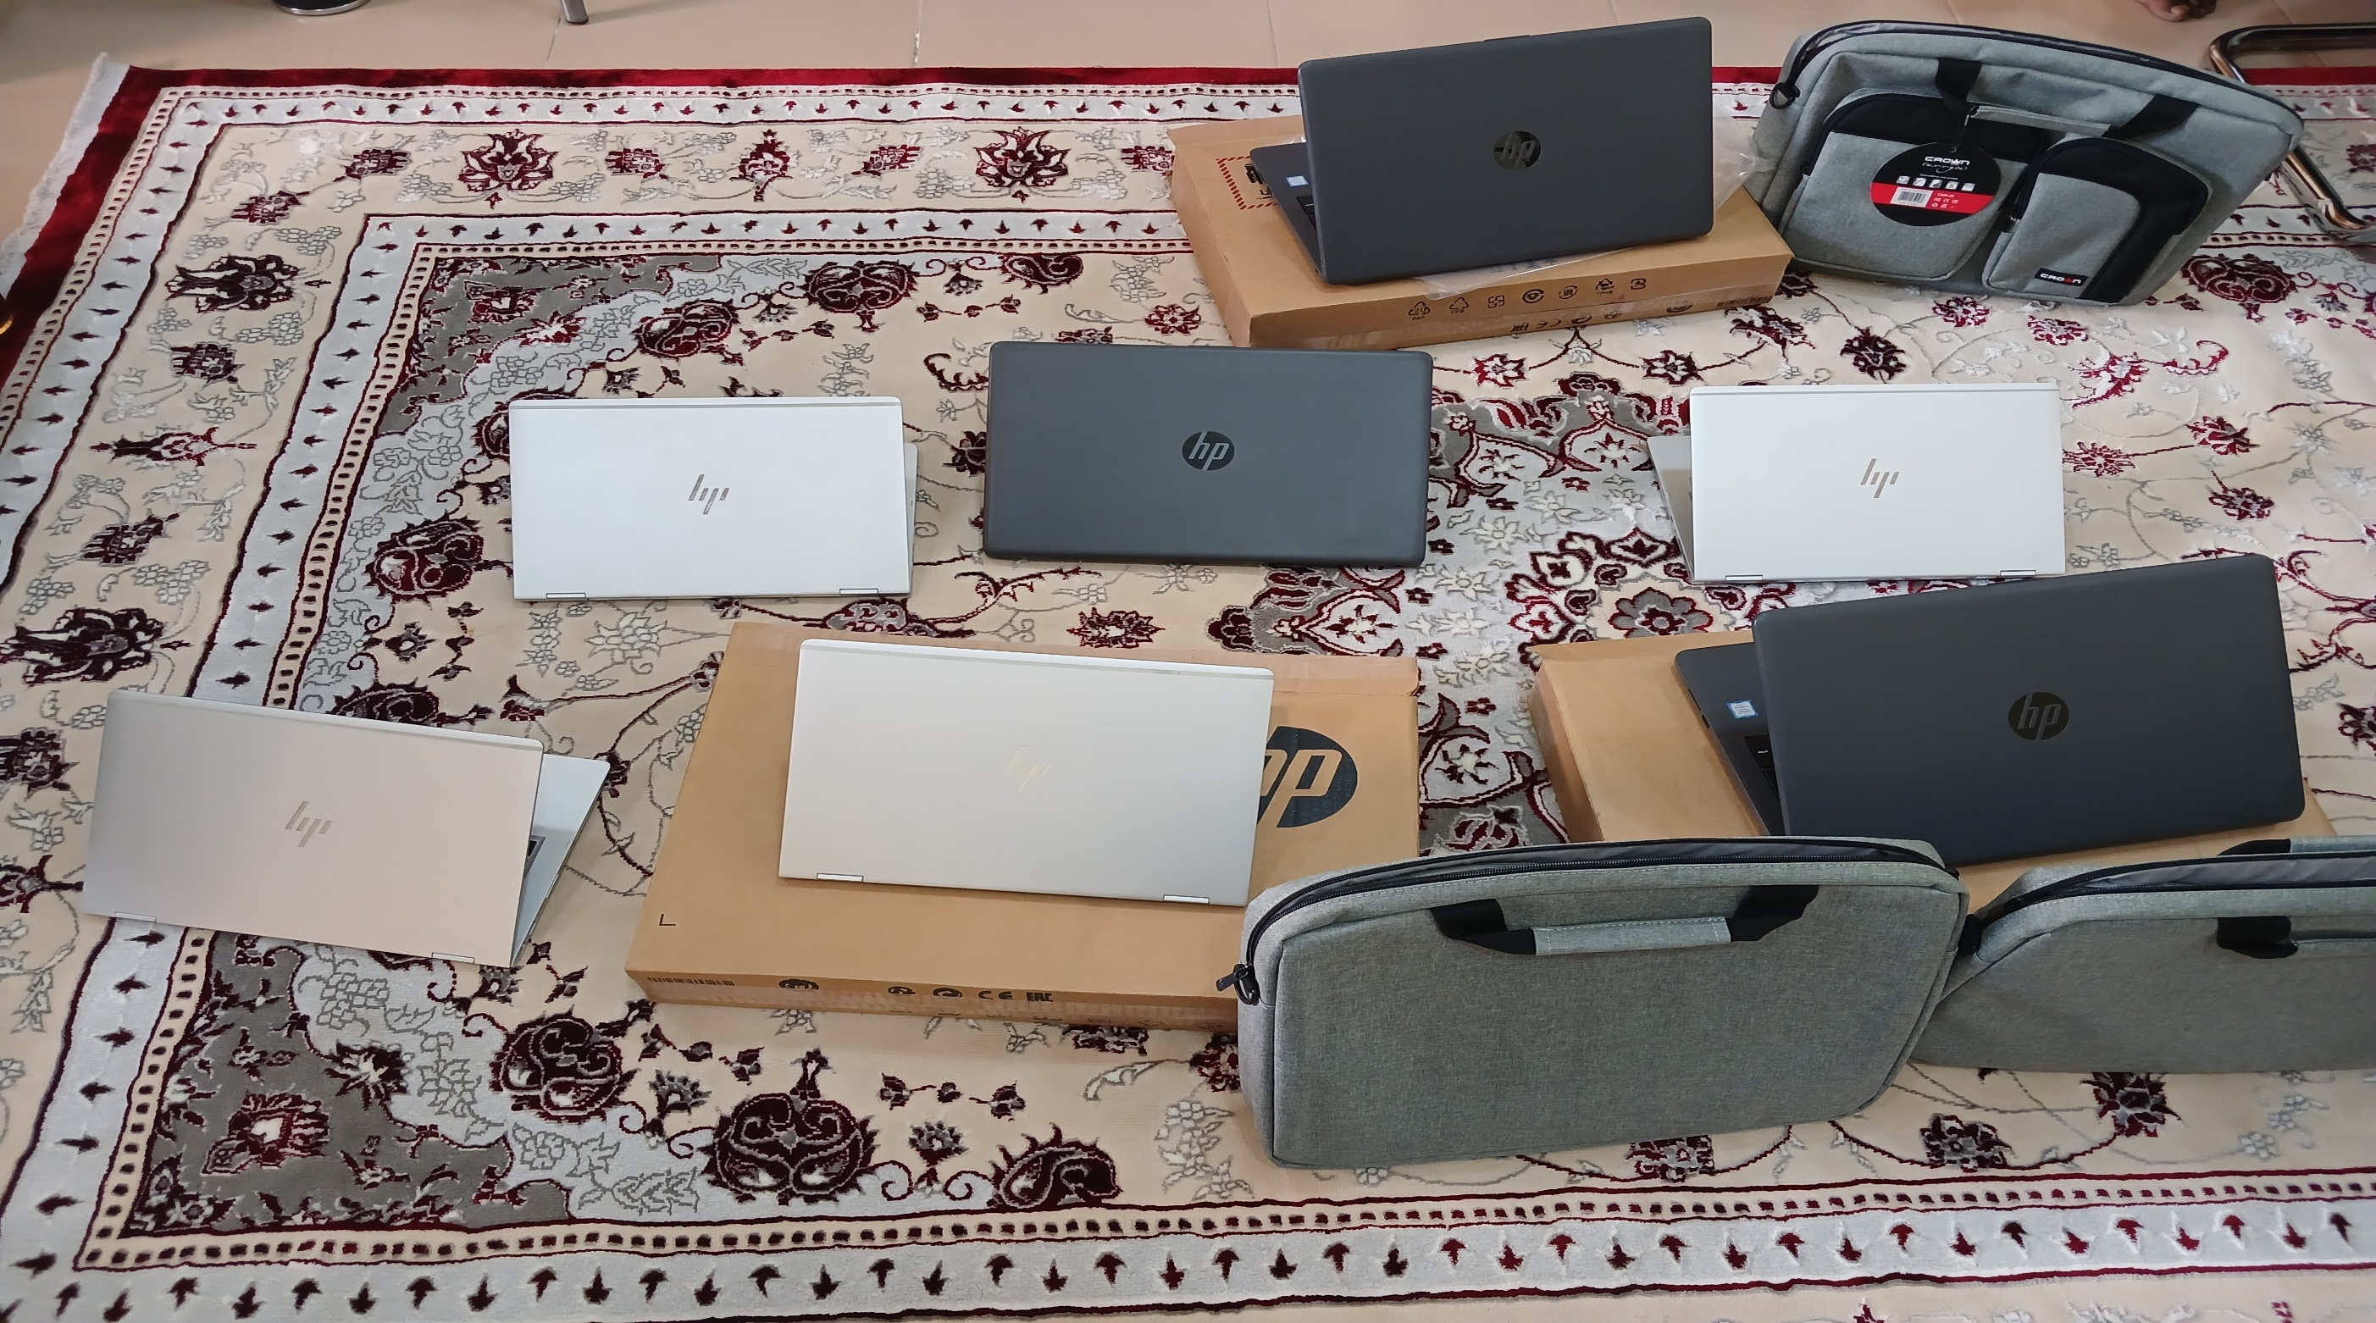
.
PURCHASE OF COMPUTERS FOR KHETFUND STAFF

Slide 11
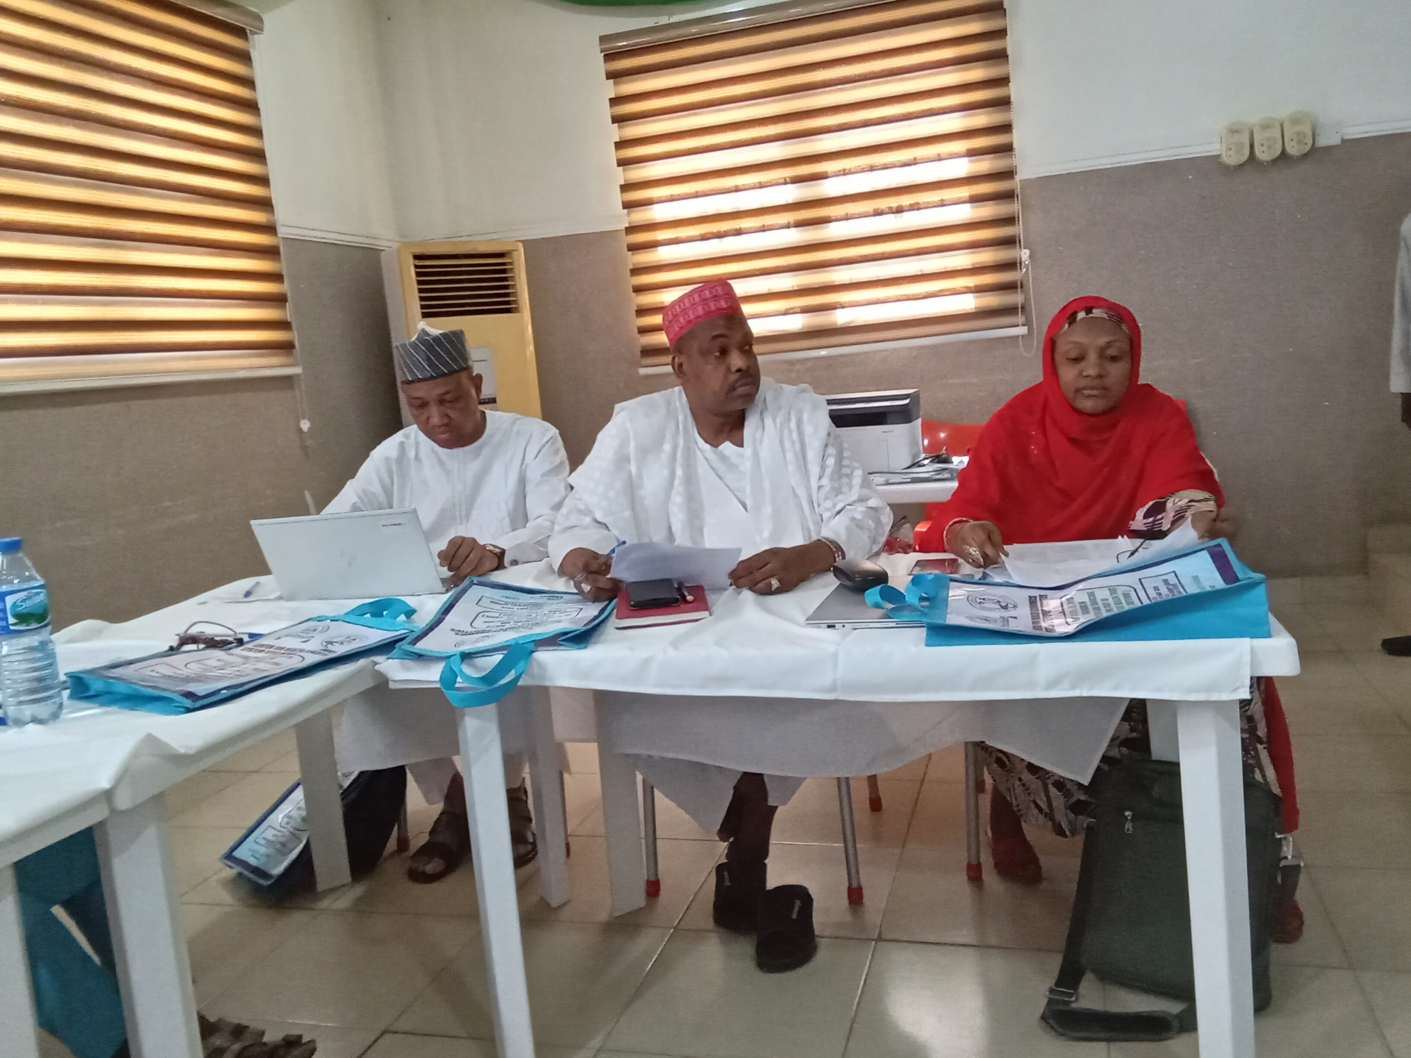
.
CAPACITY BUILDING OF KHETFUND STAFF ON HEALTHCARE FINANCING

Slide 12
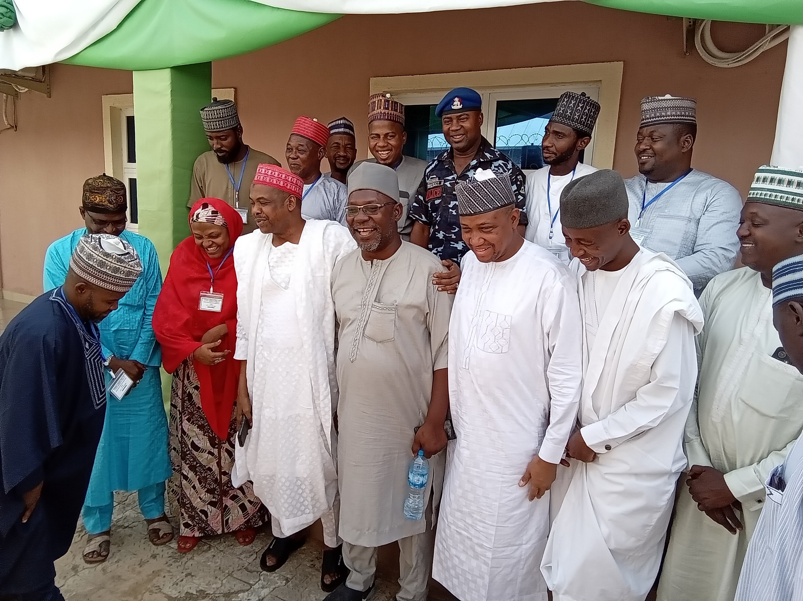
.
Capacity Building of KHETFUND Staff on Healthcare Financing

Slide 13
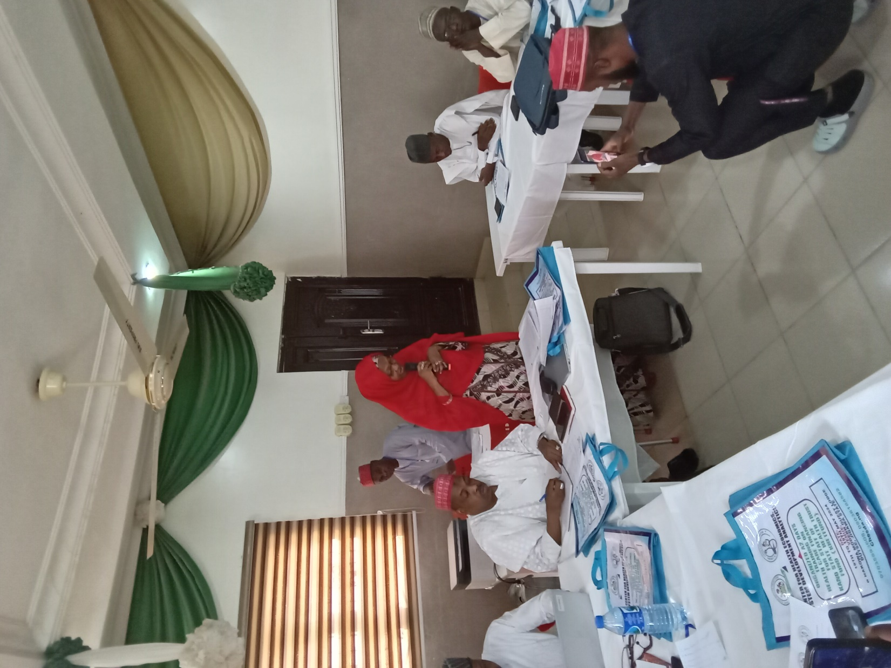
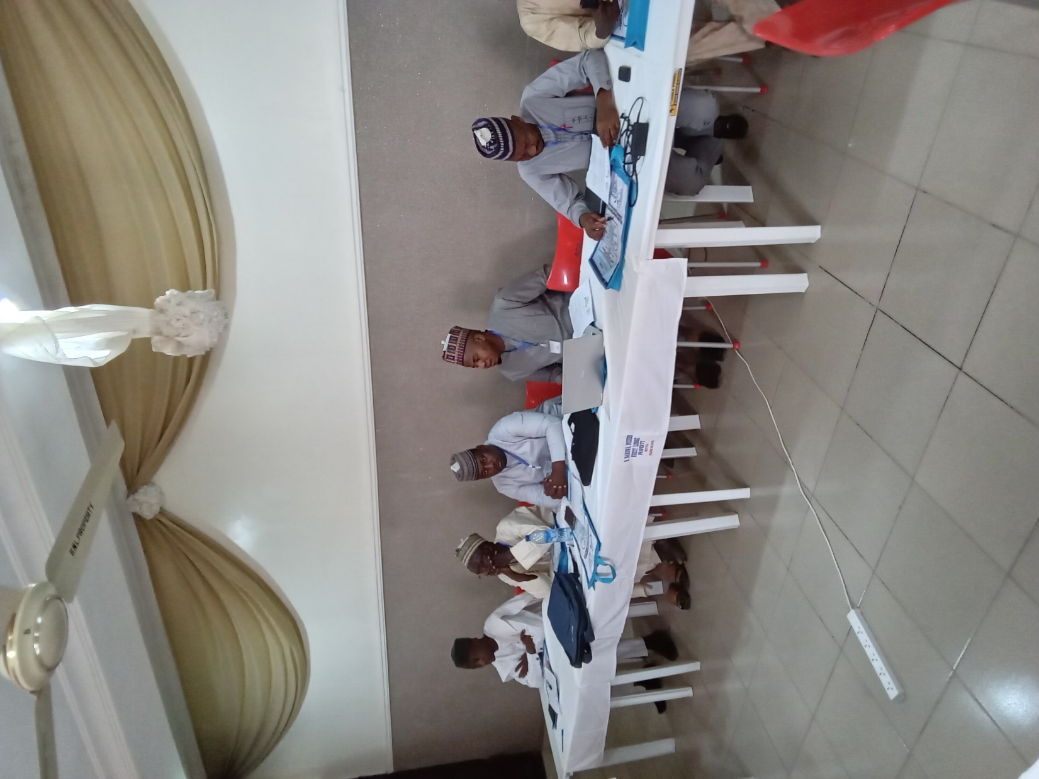
.
Capacity Building of KHETFUND Staff on Healthcare Financing

Slide 14
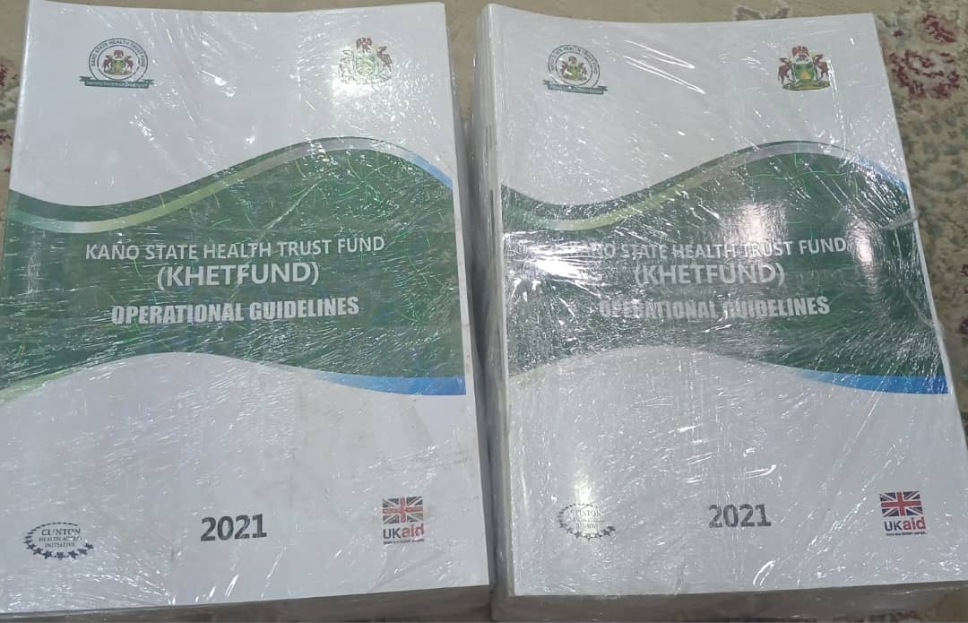
.
PRINTING OF KHETFUND OPERATIONAL GUIDELINES

Slide 15
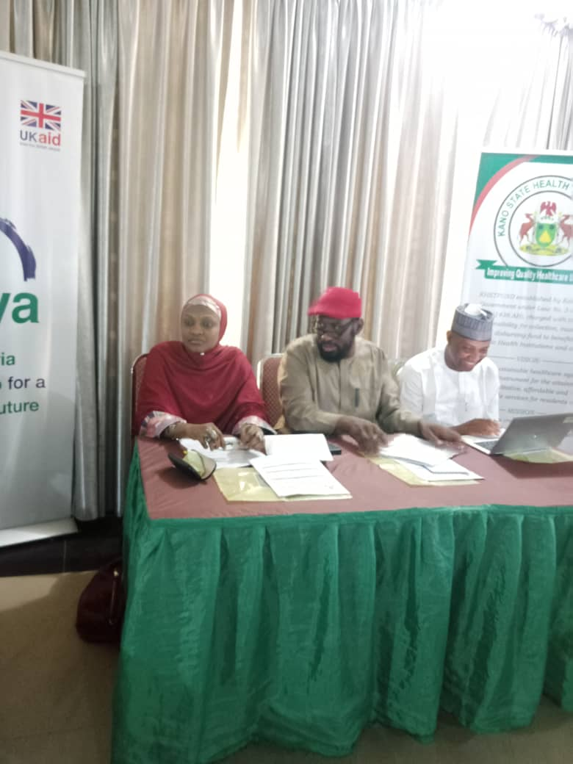
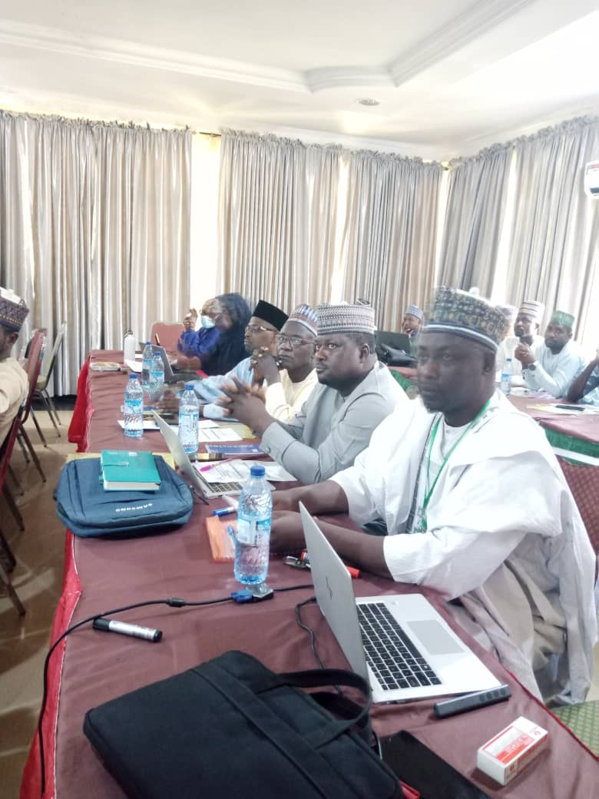
.
REFRESHER TRAINING OF KHETFUND FOCAL PERSONS

Slide 16
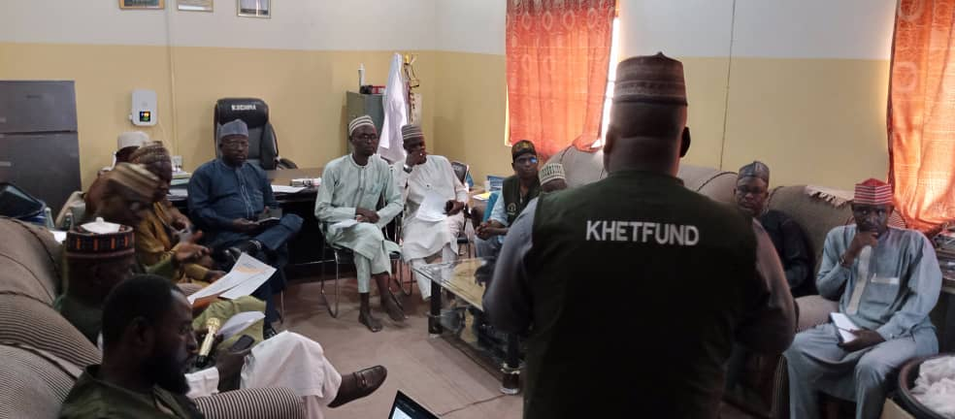
.
SENSITIZATION MEETING @ HMB BICHI ZONE

Slide 17
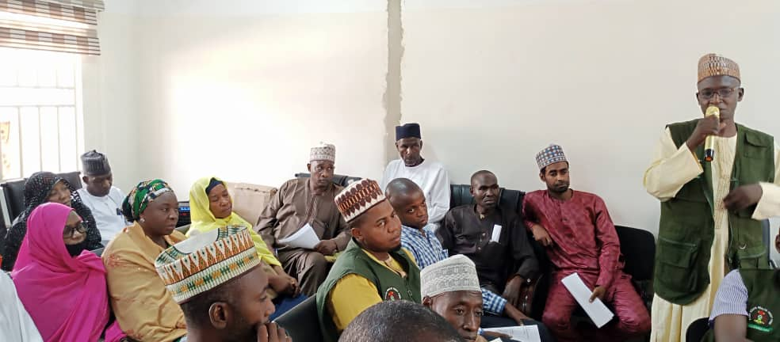
.
SENSITIZATION MEETING @ HMB HBPH ZONE

Slide 18
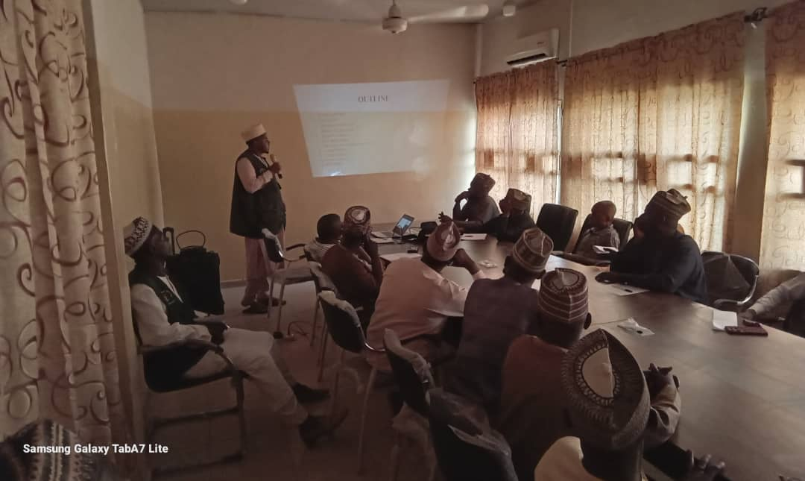
.
SENSITIZATION MEETING @ HMB SMSSH ZONE

Slide 19
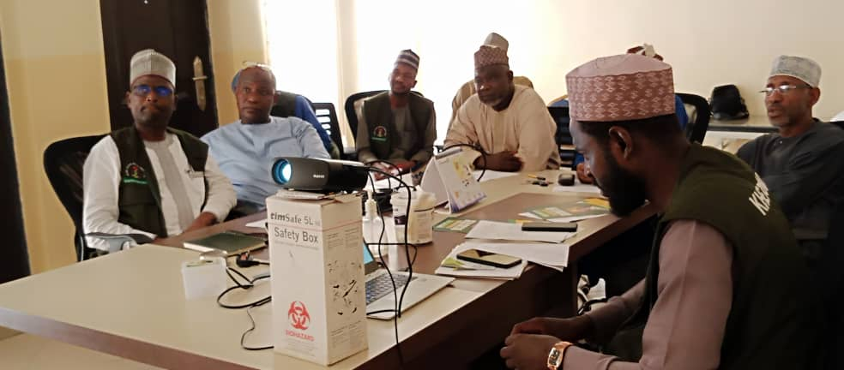
.
SENSITIZATION MEETING @ HMB MMSH ZONE

Slide 20
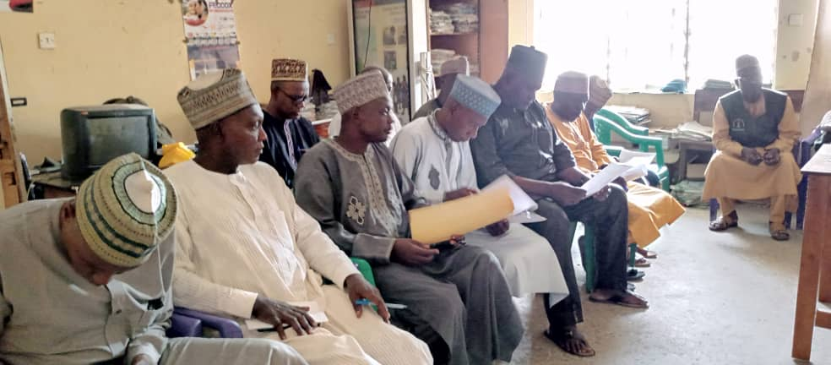
.
SENSITIZATION MEETING @ HMB GWARZO ZONE

Slide 21
.
Office Equipment/Furniture @ College of Health Science and Technology

Slide 22
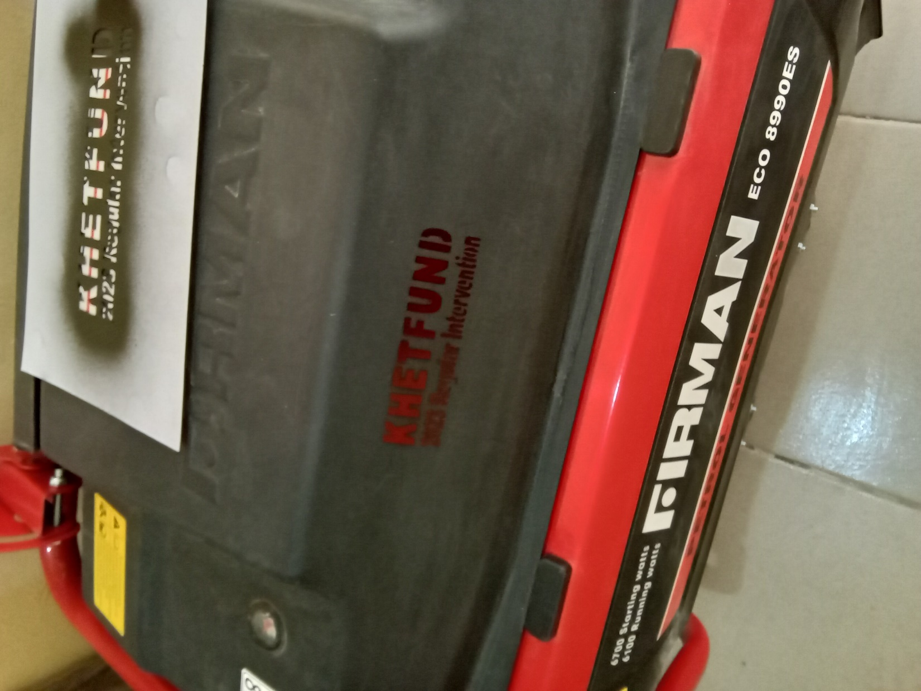
.
Office Equipment/Furniture @ College of Health Science and Technology

Slide 23
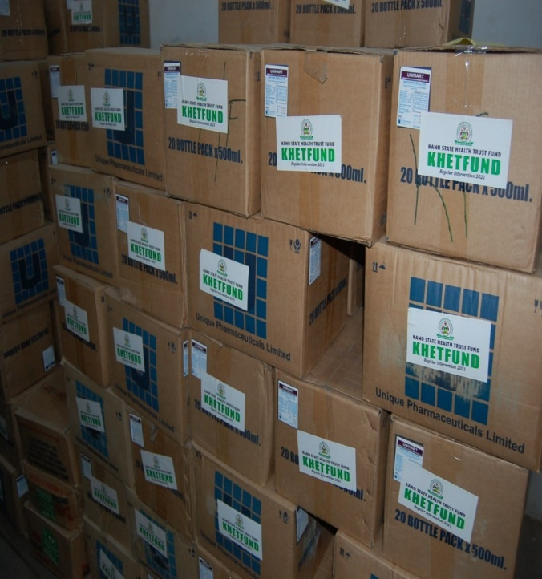
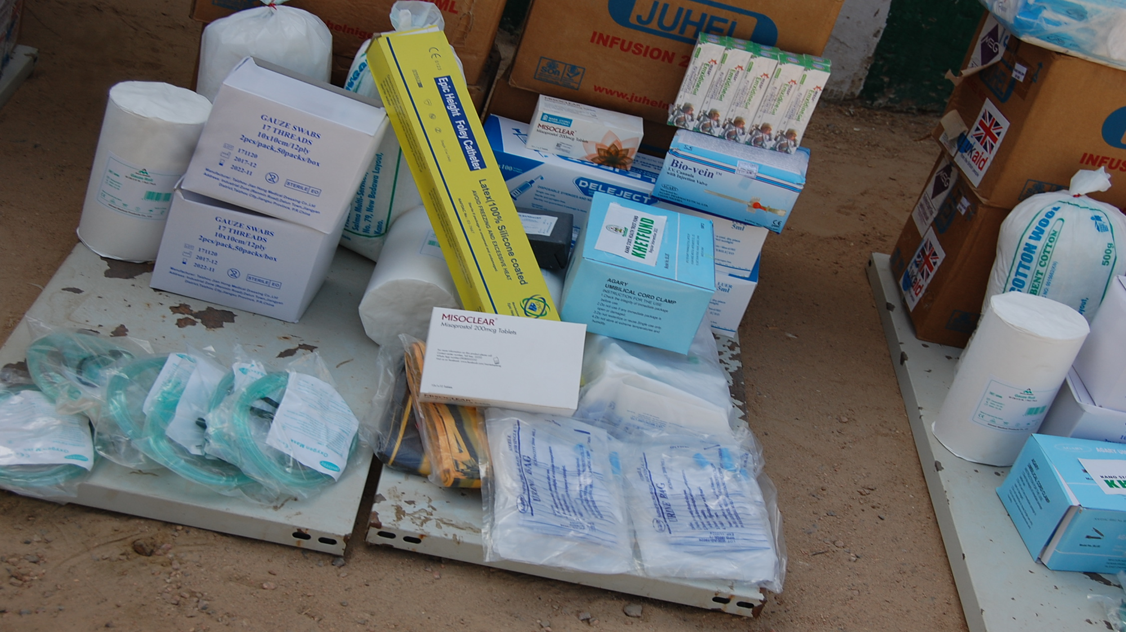
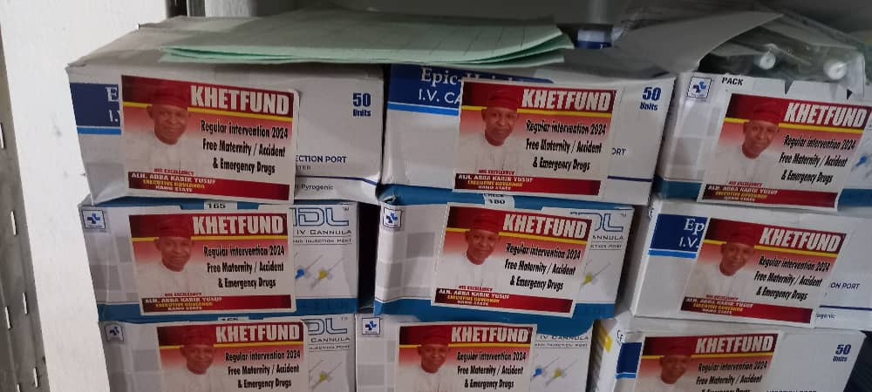
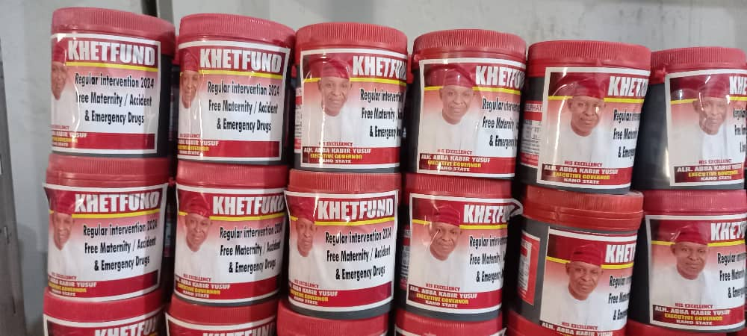
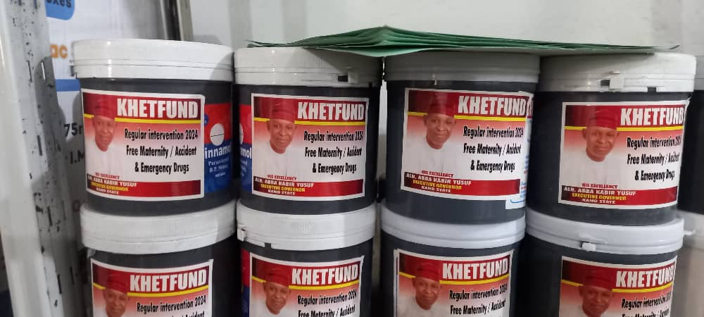
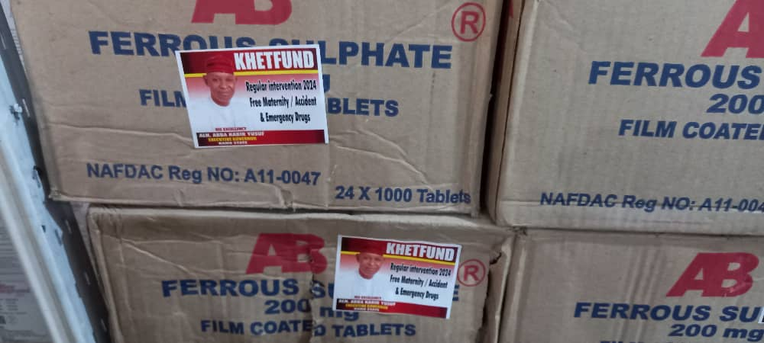
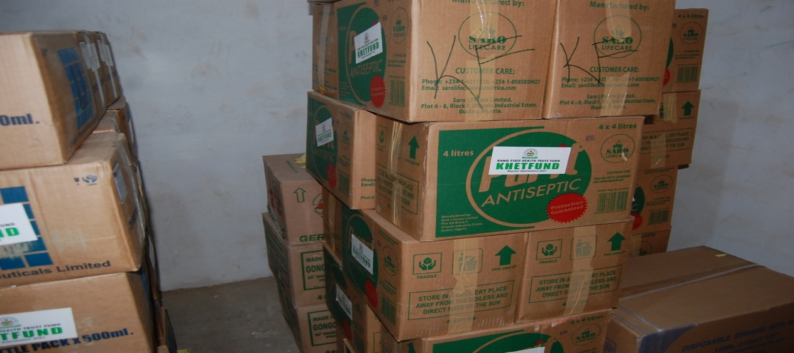
Distribution of Commodities to Healthcare Facilities for Free Maternal and Child Care Programe

Slide 24
Distribution of Commodities to Healthcare Facilities for Free Maternal and Child Care Program

Slide 25
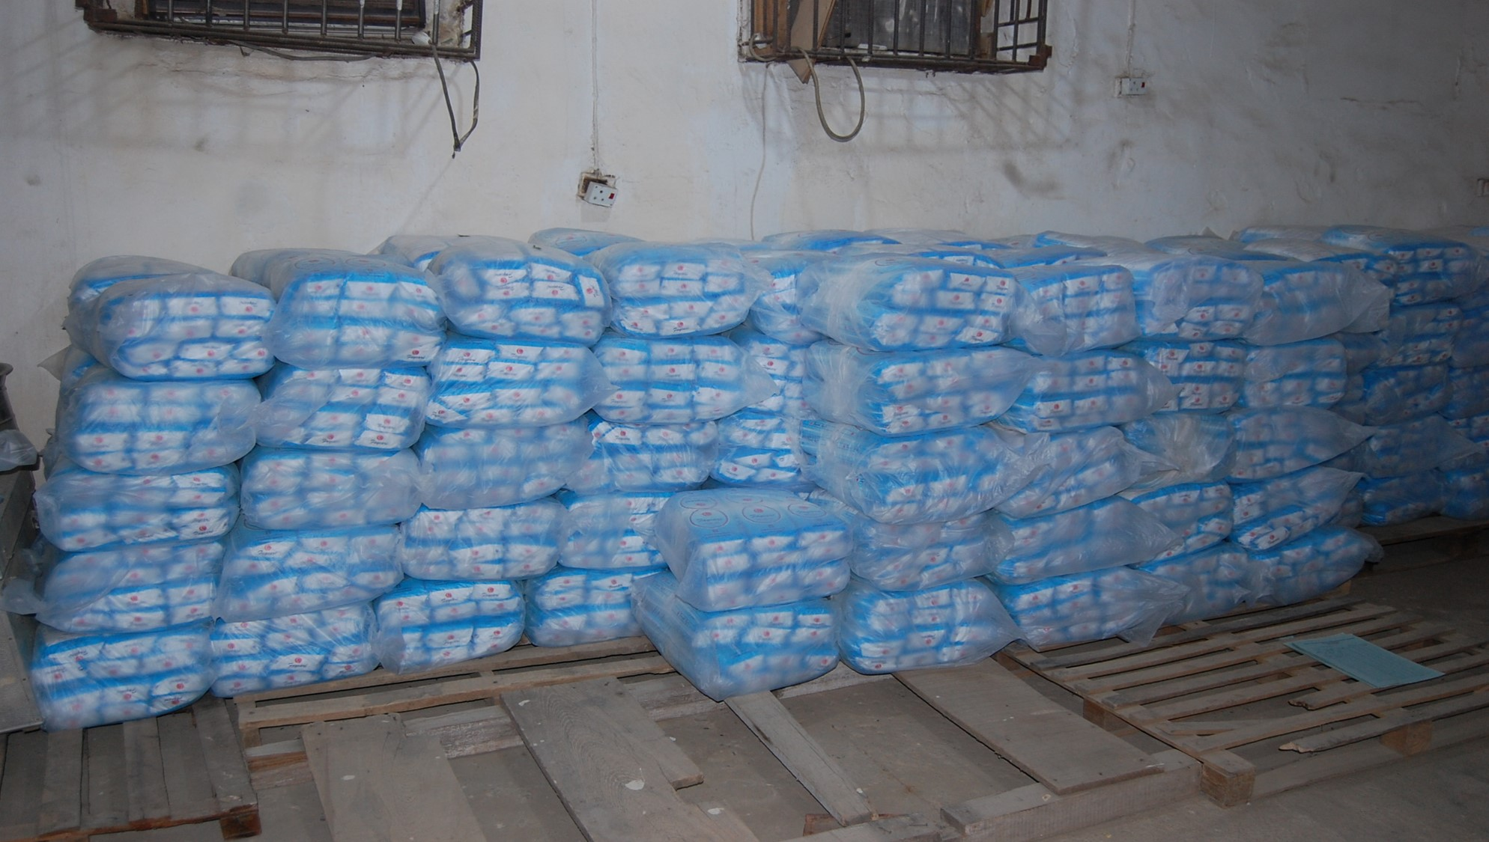
Distribution of Commodities to Healthcare Facilities for Free Maternal and Child Care Program

Slide 26
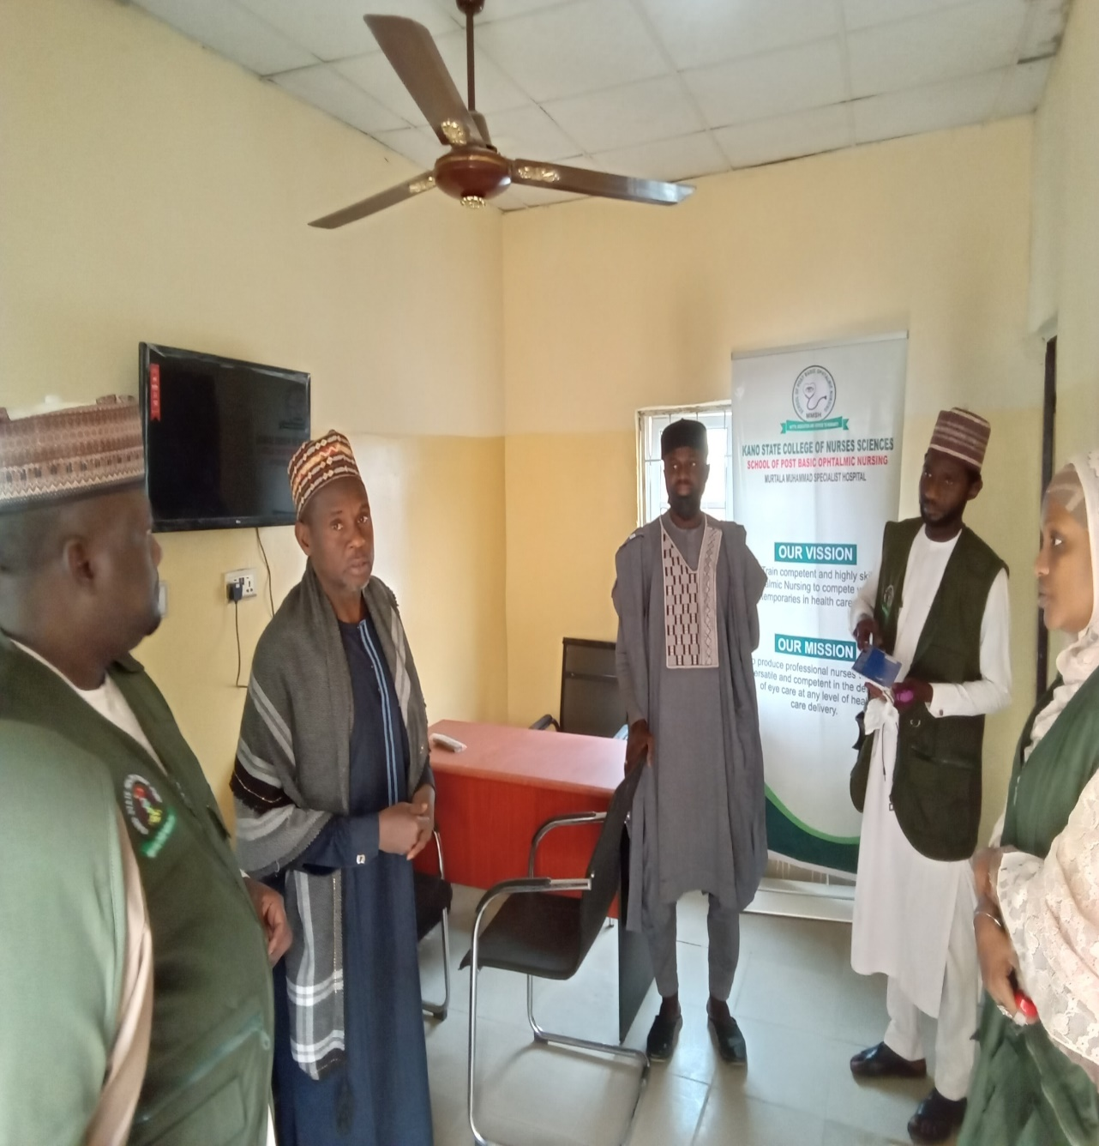
Renovation and Equipping of School of Ophthalmic Nursing

Slide 27
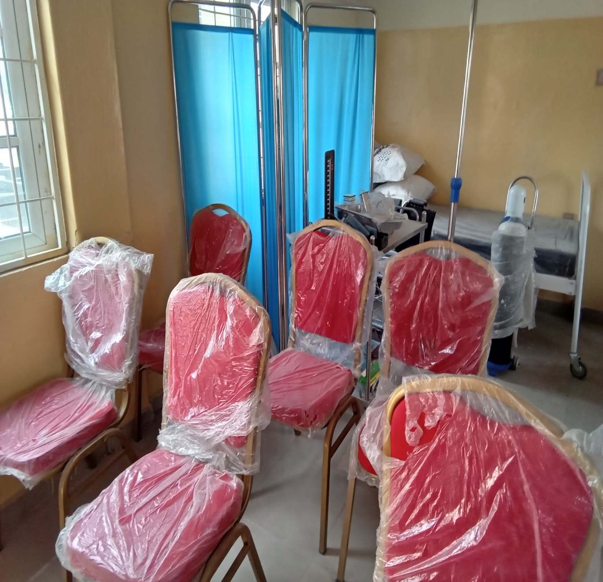
Renovation and Equipping of School of Ophthalmic Nursing

Slide 28
Renovate and Equipped School of Ophthalmic Nursing

Slide 29
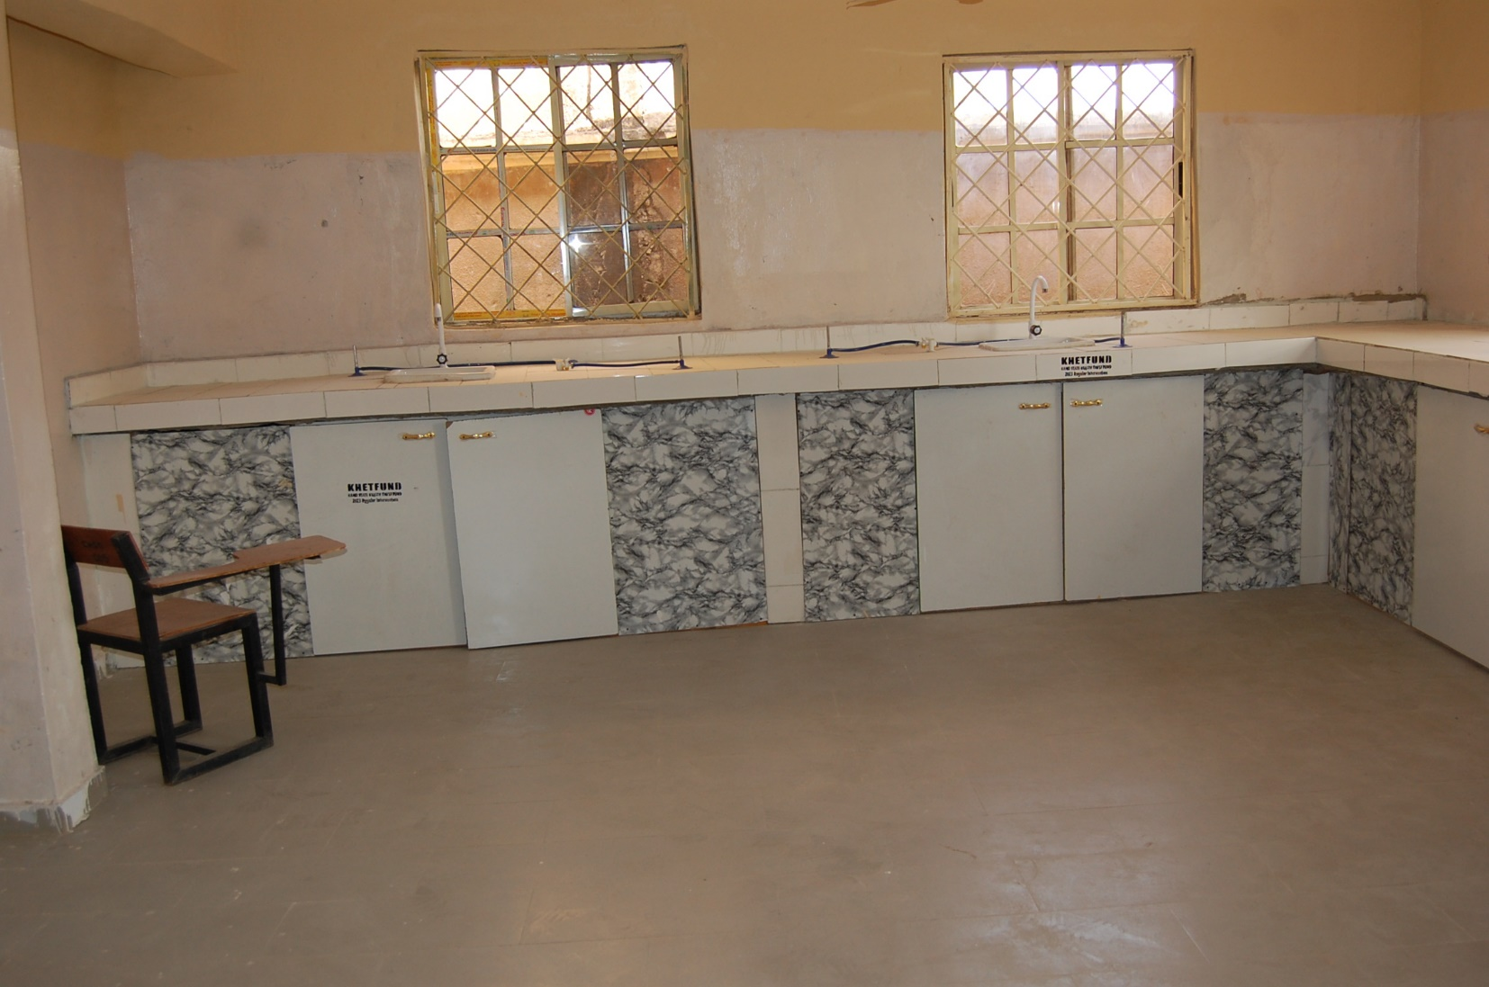
Laboratory and Text Books @ School of Midwifery Gwarzo for the Accreditation Exercise

Slide 30
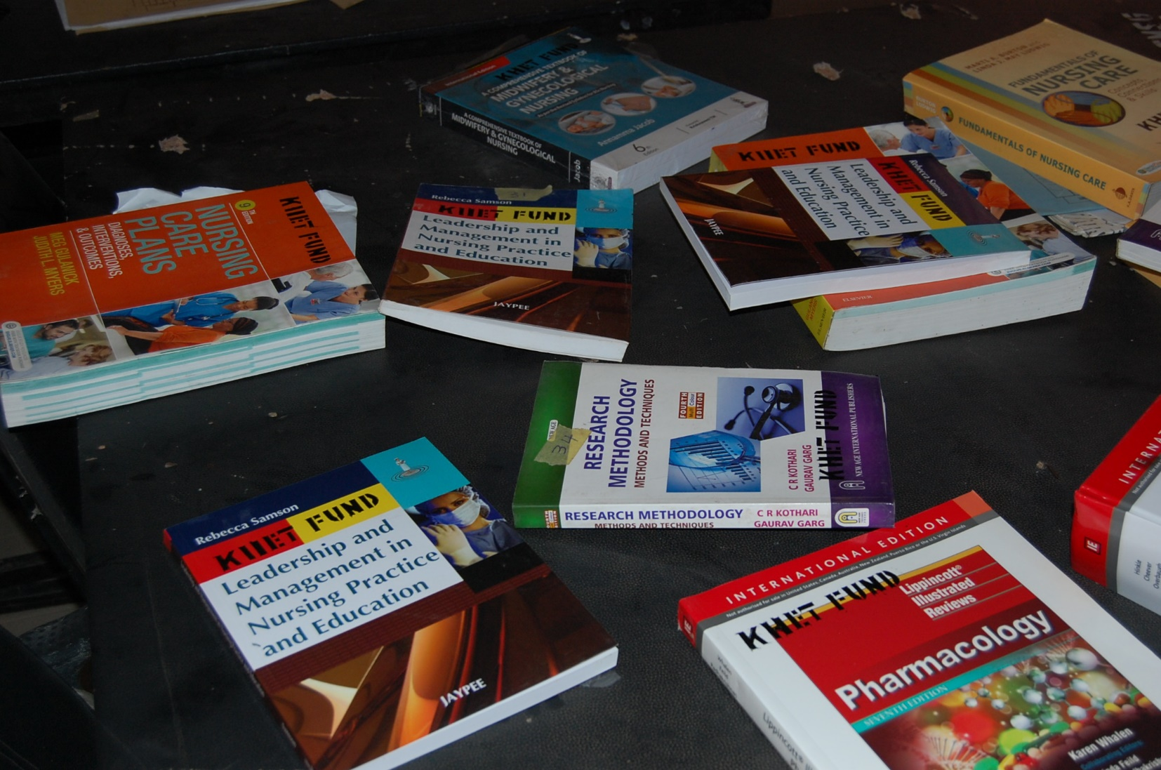
Laboratory and Text Books @ School of Midwifery Gwarzo for the Accreditation Exercise

Slide 31
Computers @ School of Midwifery Gwarzo
"C:\Users\hp\Desktop\Picture\20240131_111526.jpg"

Slide 32
KHETFUND Supported School of Nursing Kano with Text Books and Journals

Slide 33
Demostration Room at School of Midwifery Gwarzo

Slide 34
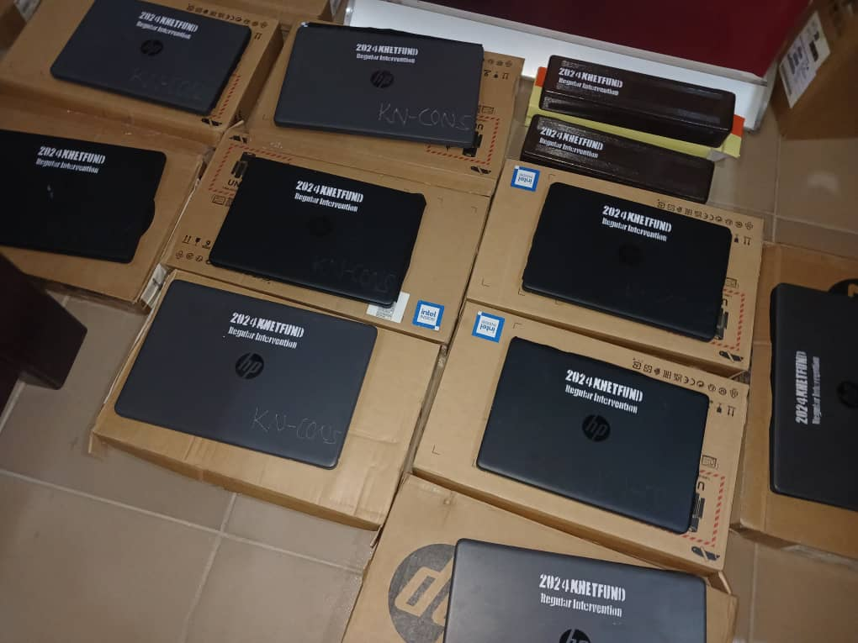
TEACHING AIDS @ CONS

Slide 35
Renovated and Equipped Laboratory at College of Nursing Services Madobi Campus

Slide 36
College of Nursing Madobi 2023 Final Qualifying Examination

Slide 37
College of Nursing Madobi 2023 Final Qualifying Examination

Slide 38
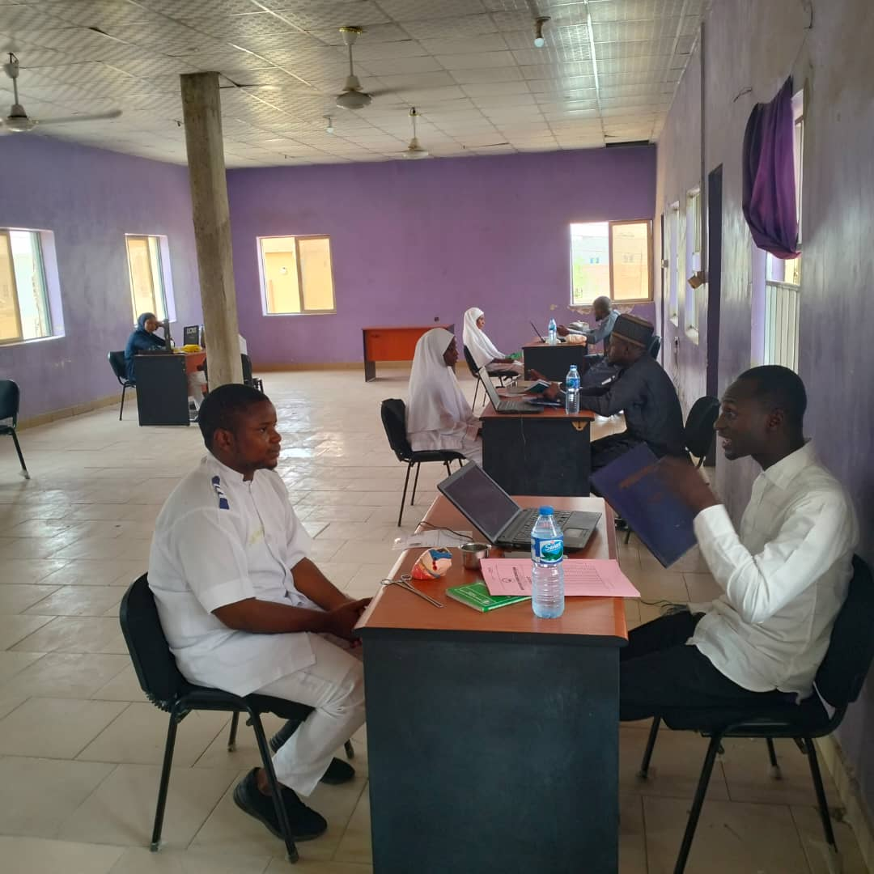
College of Nursing Science 2024 Final Qualifying Examination

Slide 39
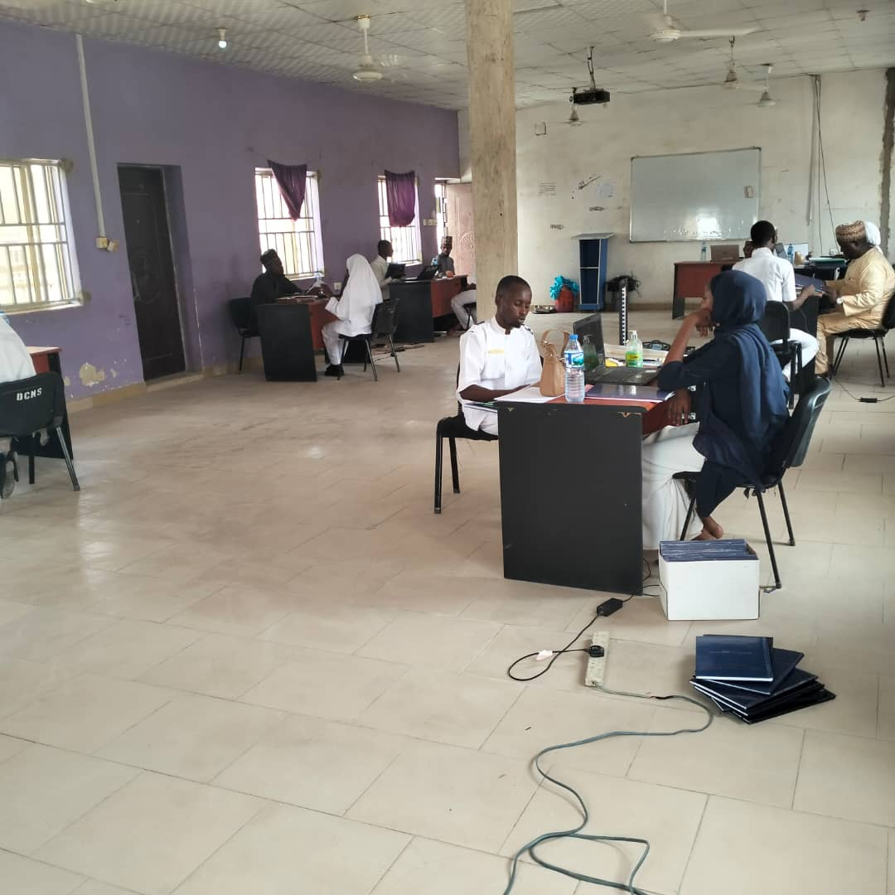
College of Nursing Science 2024 Final Qualifying Examination

Slide 40
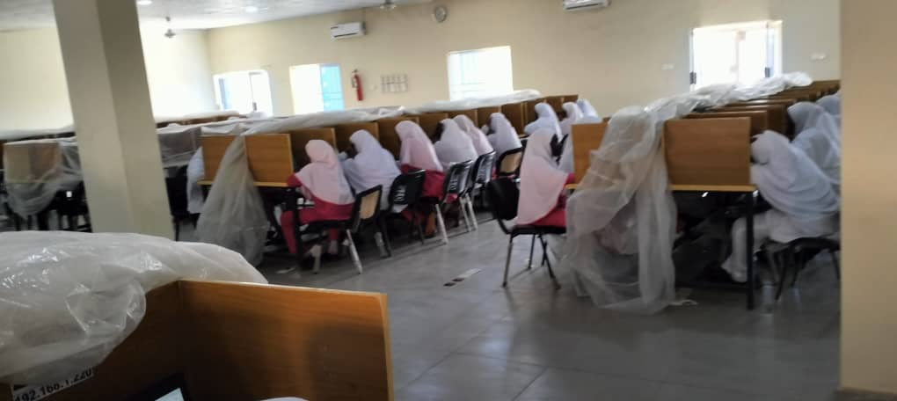
2024 FINAL QUALIFYING EXAM @ CONS (SCHOOLS OF MIDWIFERY)

Slide 41
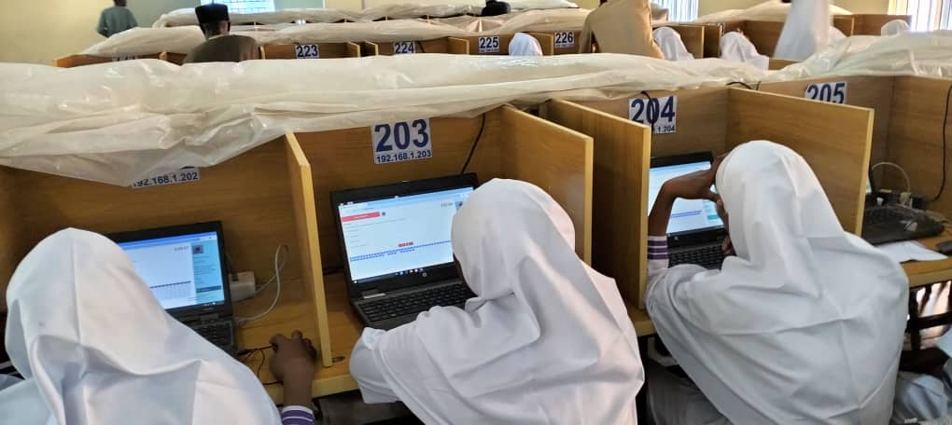
2024 FINAL QUALIFYING EXAM @ CONS (SCHOOLS OF MIDWIFERY)

Slide 42
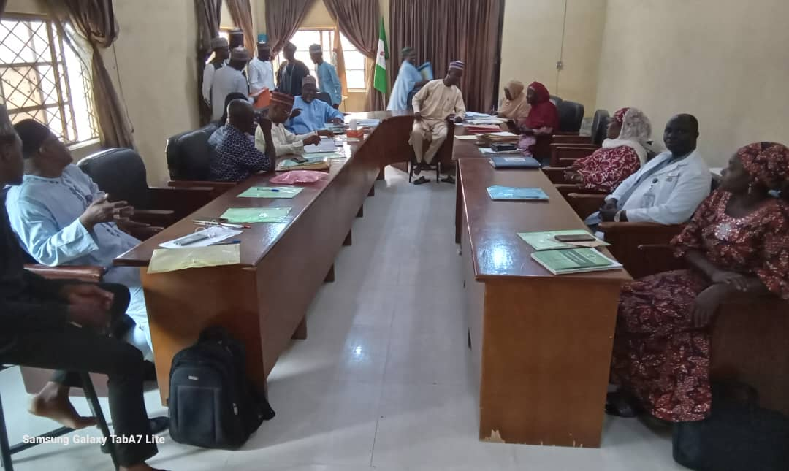
2024 ACCREDITATION EXERCISE @ SCHOOL OF HYGIENE

Slide 43
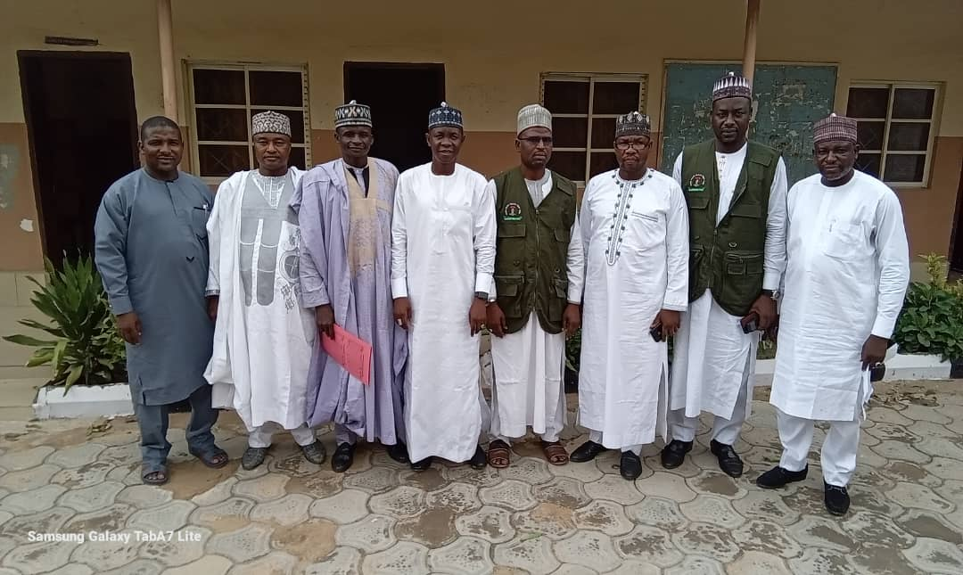
2024 ACCREDITATION EXERCISE @ SCHOOL OF HYGIENE

Slide 44
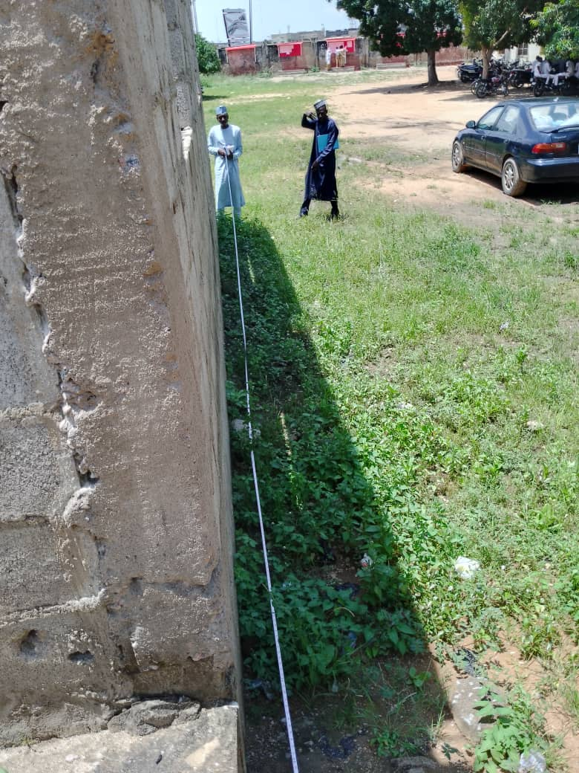
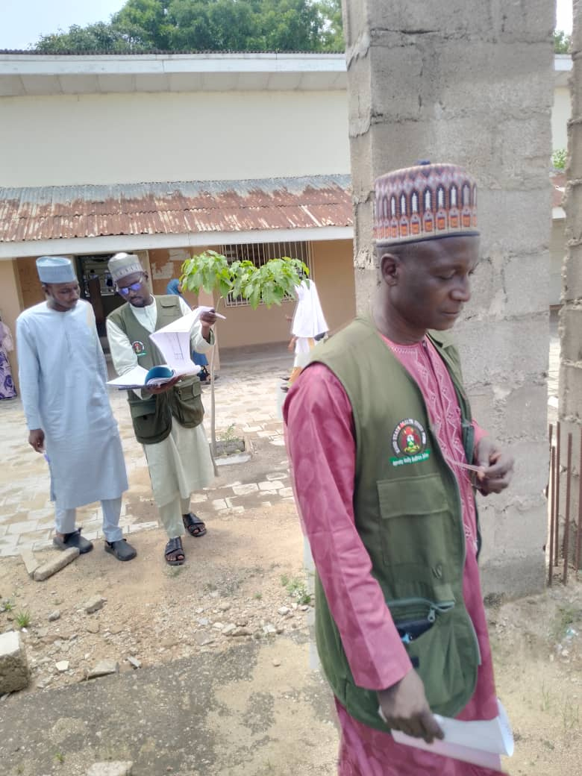
2024 PRE-FUNDING VERIFICATION EXERCISE @ SMJGH

Slide 45
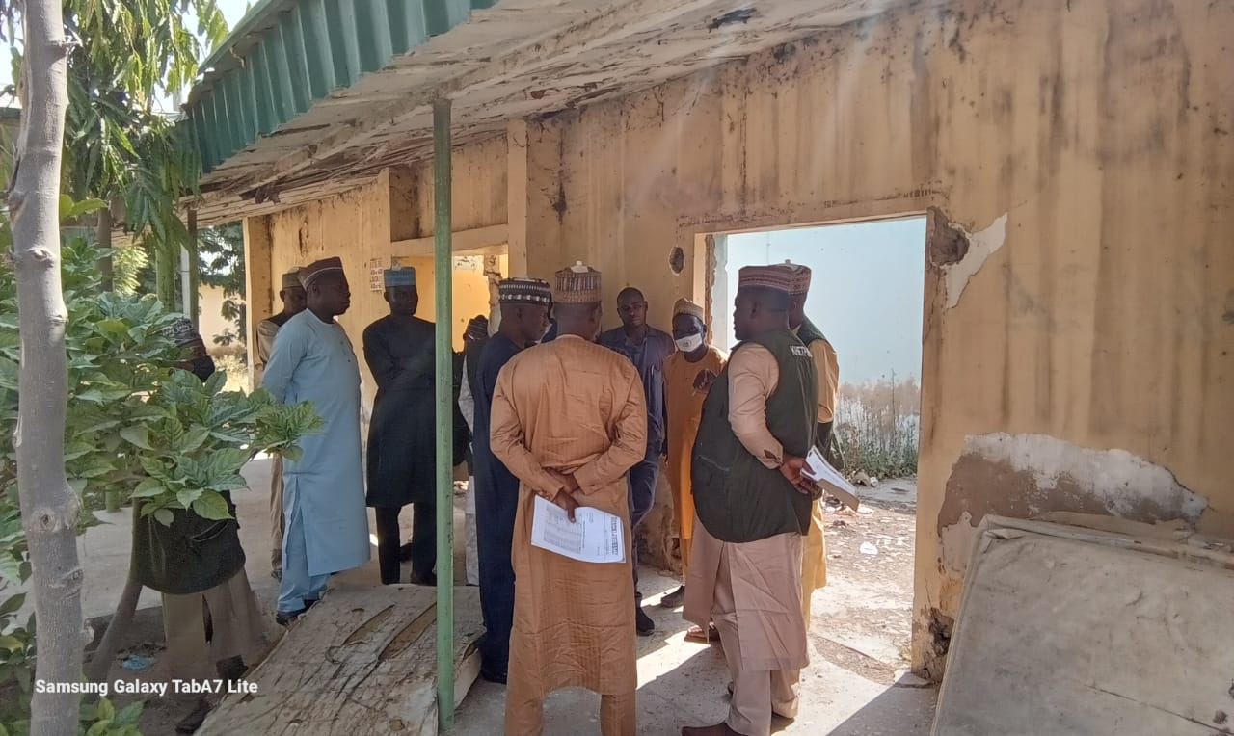
2024 PRE-FUNDING VERIFICATION EXERCISE @ TIGA GH

Slide 46
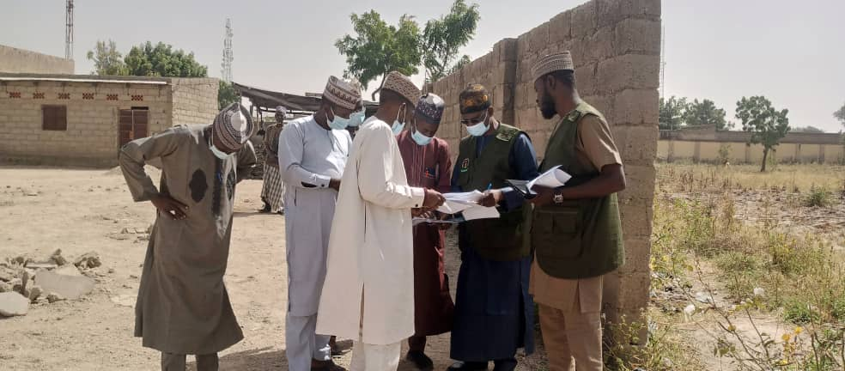
2024 PRE-FUNDING VERIFICATION EXERCISE @ RANO GH

Slide 47
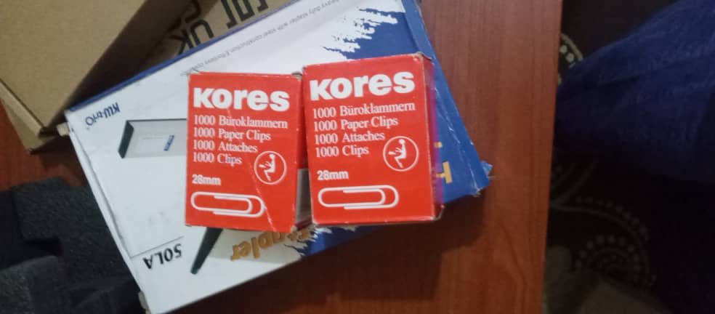
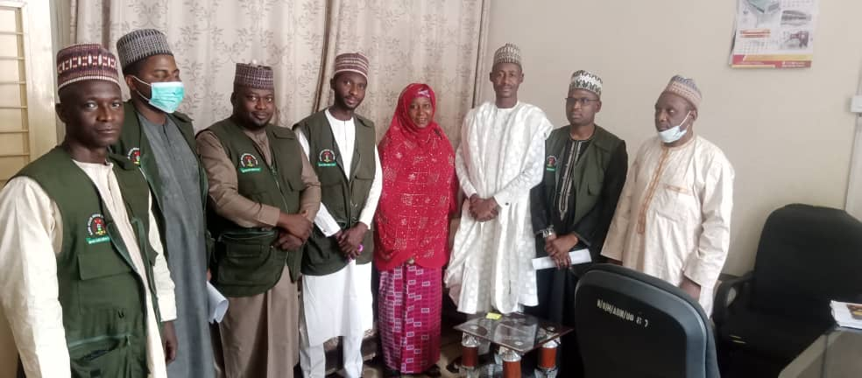
OFFICE EQUIPMENT/STATIONARIES @ KNCDC

Slide 48
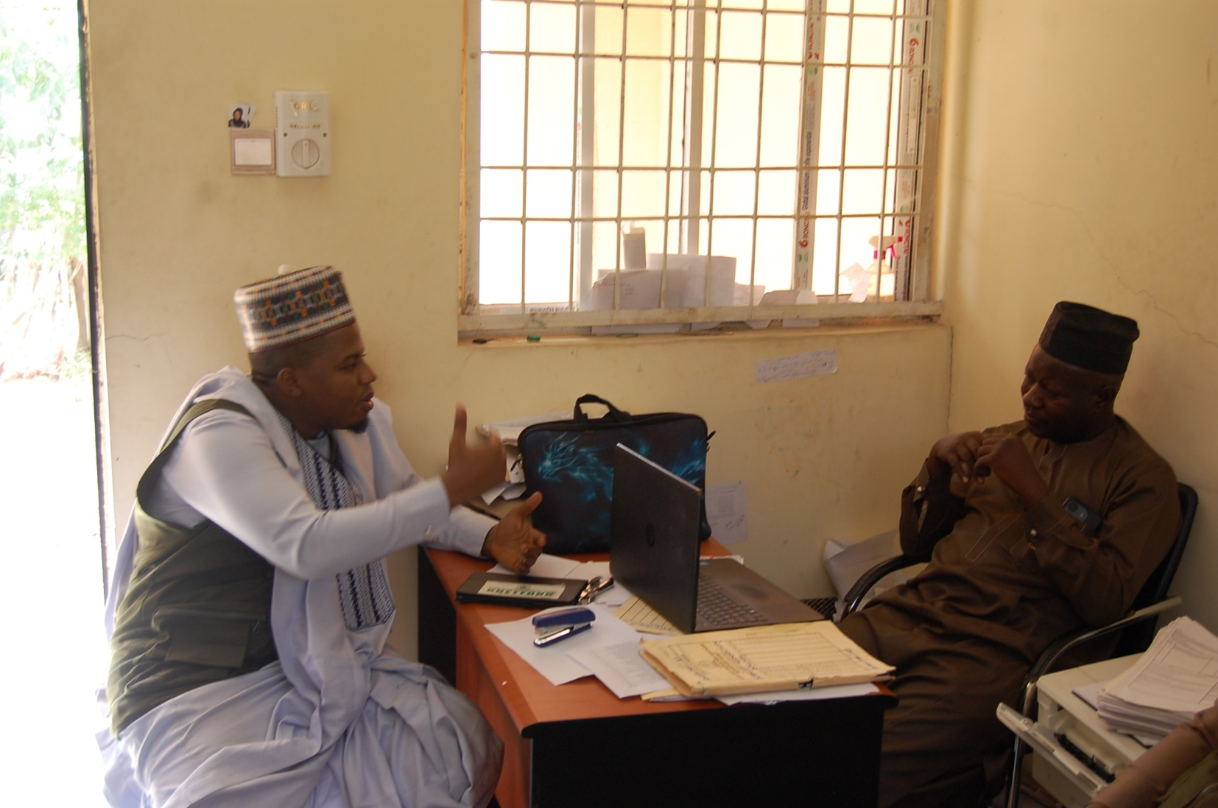
VULNERABLE GROUP VERIFICATION @ KSCHMA

Slide 49
VULNERABLE GROUP VERIFICATION @ KSCHMA

Slide 50
VULNERABLE GROUP VERIFICATION @ KSCHMA

Slide 51
TEACHING AIDS @ CONS GWARZO CAMPUS

Slide 52
15% COUNTERPART FUNDING OF PHARMA GRADE @ DMCSA

Slide 53
15% COUNTERPART FUNDING OF PHARMA GRADE @ DMCSA

Slide 54
HOSPITAL EQUIPMENT @ AIUC

Slide 55
HOSPITAL EQUIPMENT @ AIUC

Slide 56
POST FUNDING VERIFICATION FOR INSTALLATION OF SOLAR @ SMJGH

Slide 57
INSTALLATION OF SOLAR @ SMJGH

Slide 58
INSTALLATION OF SOLAR @ SMJGH

Slide 59
HOSPITAL EQUIPMENT @ SMJGH

Slide 60
HOSPITAL EQUIPMENT @ SMJGH

Slide 61
UPGRADEMENT OF ICT CENTER @ SOHT KANO

Slide 62
UPGRADEMENT OF ICT CENTER @ SOHT KANO

Slide 63
UPGRADEMENT OF ICT CENTER @ SOHT KANO

Slide 64
POST FUNDING VERIFICATION OF MAPPING TRADITIONAL MEDICINE VENDOR @ PHIMA

Slide 65
POST FUNDING VERIFICATION OF MAPPING TRADITIONAL MEDICINE VENDOR @ PHIMA

Slide 66
CONSTRUCTION OF HIV PAEDIATRIC @ MMSH

Slide 67
CONSTRUCTION OF HIV PAEDIATRIC @ MMSH

Slide 68
CONSTRUCTION OF HIV PAEDIATRIC @ MMSH

Slide 69
VERIFICATION OF RESOURCE VISIT FOR ACCREDITATION @ SOHT BBJ

Slide 70
VERIFICATION OF RESOURCE VISIT FOR ACCREDITATION @ SOHT BBJ

Slide 71
HOSPITAL EQUIPMENT @ MAWTH

Slide 72
SOLAR POWER @ DAMBATTA GENERAL HOSPITAL

Slide 73
ACCREDITATION OF INTERNAL MEDICINE @ MAWTH

Slide 74
ACCREDITATION OF INTERNAL MEDICINE @ MAWTH

Slide 75
DENTAL CHAIR @ IDH

Slide 76
MEDICAL EQUIPMENT @ IDH

Slide 77
MEDICAL EQUIPMENT @ JAAFR CLINIC

Slide 78
MEDICAL EQUIPMENT @ JAAFR CLINIC

Slide 79
MEDICAL EQUIPMENT @ YADAKUNYA

Slide 80
MEDICAL EQUIPMENT @ YADAKUNYA

Slide 81
DISTRIBUTION OF DENTAL CHAIRS @ PHCMB

Slide 82
12no MODERN DENTAL CHAIRS @ PHCMB

Slide 83
ACCREDITATION OF INTERNAL MEDICINE @ MAWTH

Slide 84
ACCREDITATION OF INTERNAL MEDICINE @ MAWTH

Slide 85
DENTAL CHAIR @ IDH

Slide 86
MEDICAL EQUIPMENT @ IDH

Slide 87
MEDICAL EQUIPMENT @ JAAFR CLINIC

Slide 88
MEDICAL EQUIPMENT @ JAAFR CLINIC

Slide 89
MEDICAL EQUIPMENT @ YADAKUNYA

Slide 90
MEDICAL EQUIPMENT @ YADAKUNYA

Slide 91
MEDICAL EQUIPMENT @ GEZAWA GH

Slide 92
MEDICAL EQUIPMENT @ GEZAWA GH

